Slide 1





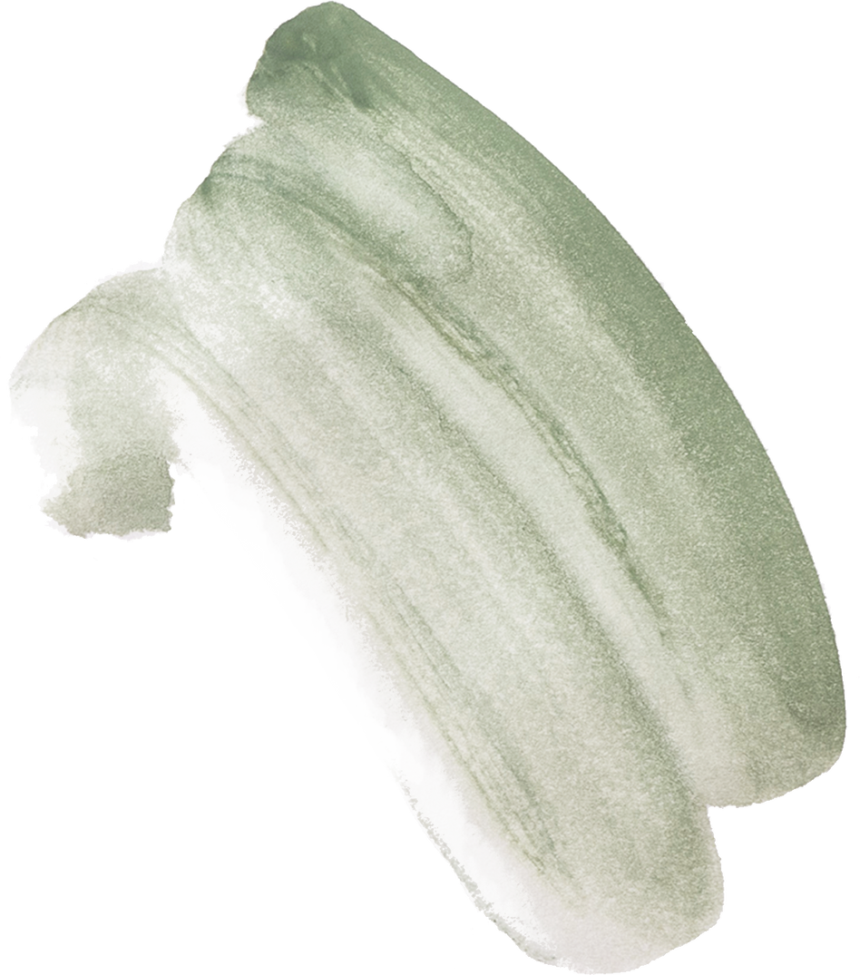




IMAGE ENCRYPTION AND DECRYPTION
USING TDES

Slide 2


MD ZEESHAN SIDDIQUI 20054-CM-110
SAI SANTHOSH 20054-CM-094
T. SAI VAMSHI 20054-CM-118
HAMILPURE ASHMITH 20054-CM-104
MOHAMMED ZAID AHMED 20054-CM-087
GROUP
MEMBERS

Slide 3
!1. ABSTRACT
!2.DES
!3.TRIPLE DES
!4.ENCRYPTION
DECRYPTION
Table Of Contents
!5.TRIPLE DES
ALGORITHM
!6.PROCESS
!7.IMPLEMENTATION
!8.CONCLUSION
!9.REFERENCES

Slide 4
01.
ABSTRACT
In today’s world almost all digital services like internet communication, medical and military imaging systems, multimedia system needs a high level and protected security.
There is a need for security level in order to safely store and transmit digital image containing critical information.
Therefore, there is a need for image encryption techniques in order to hide images from such attacks.
In this system we use Triple DES(Data Encryption Standard) in order to hide images.
Such Encryption technique helps to avoid Active and Passive Attacks.

Slide 5
02.
DES:
Data Encryption Standard

Slide 6
Data Encryption Standard
The data Encryption Standard(DES) is a symmetric-key block cipher published by the National Institute of Standards and Technology (NIST).
DES is an implementation of a Feistel Cipher, it uses 16 round Feistel structure and the block size is 64-bit.
Though, key length is 64-bit, DES has an effective key length of 56-bits, since 8 of the 64-bits of the key are not used by the encryption algorithm (function as check buts only).

Slide 7




ENCRYPTION AND DECRYPTION PROCESS
SAMPLE ENCRYPTION AND DECRYPTION PROCESS
Encryption
+
. . . . . .
. . . . . .
ALGORITHM
CIPHER TEXT
PLAIN TEXT
+
. . . . . .
Decryption
. . . . . .
ALGORITHM
CIPHER TEXT
PLAIN TEXT

Slide 8
03.
TRIPLE DES
ENCRYPTION

Slide 9
TRIPLE DES ENCRYPTION
In cryptography, Triple DES, officially the Triple Data Encryption Algorithm, is a symmetric-key block cipher, which applies the DES cipher algorithm three times to each data block.
Block sizes: 64 bits Key sizes: 168,112 or 56 bits (keying option 1,2,3 repectively).
Triple DES is an encryption technique which uses three instances of DES on same plain text.
It uses their different types of key choosing technique in first all used keys are different and in second two keys are same and one is different and in third all keys are same.

Slide 10
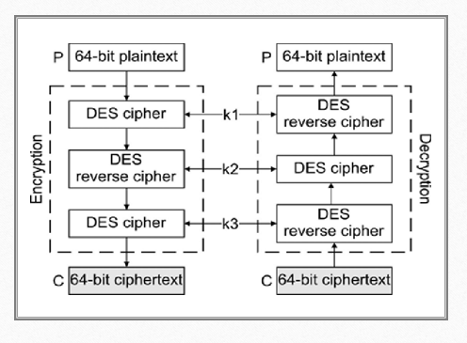
TRIPLE DES STRUCTURE

Slide 11
TRIPLE DES ALGORITHM
TDES has a fixed data block size of 8 bytes. It consists of the cascade of 3 single DES ciphers (EDE: Encryption - Decryption - Encryption), where each stage uses an independent DES sub-key.
The standard defines 2 Keying Options:
Option 1 : All sub-keys take different values (parity bits ignored). The TDES key is therefore24 bytes long (concatenation of K1,K2 and K3), to achieve 112 bits of effective security.
Option 2 : K1 matches K3 but K2 is different (parity bits ignored). The TDES key is 16 bytes long (concatenation of K1 and K2), to achieve 90 bits of effective security. In this mode, the cipher is also termed 2TDES.

Slide 12
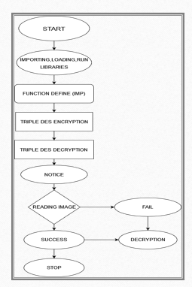
FLOW
CHART

Slide 13

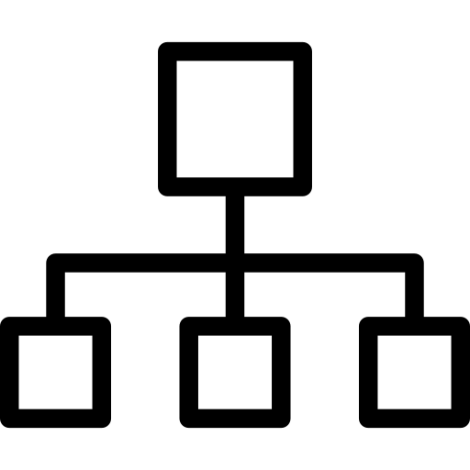


WORKING
1.Running of the libararies
2.Selecting(uploading) the file
3. Triple DES Process
4.Encrypting process
5.Decrypting process

Slide 14

Benefits of Using TDES for Image Encryption
TDES offers several benefits for image encryption, including high-level security, efficient performance, and compatibility with various operating systems and platforms.
TDES can also be easily integrated with other encryption techniques, such as public key cryptography, to enhance the overall security of the data file. Additionally, TDES supports both hardware and software implementations, making it suitable for a wide range of applications.

Slide 15
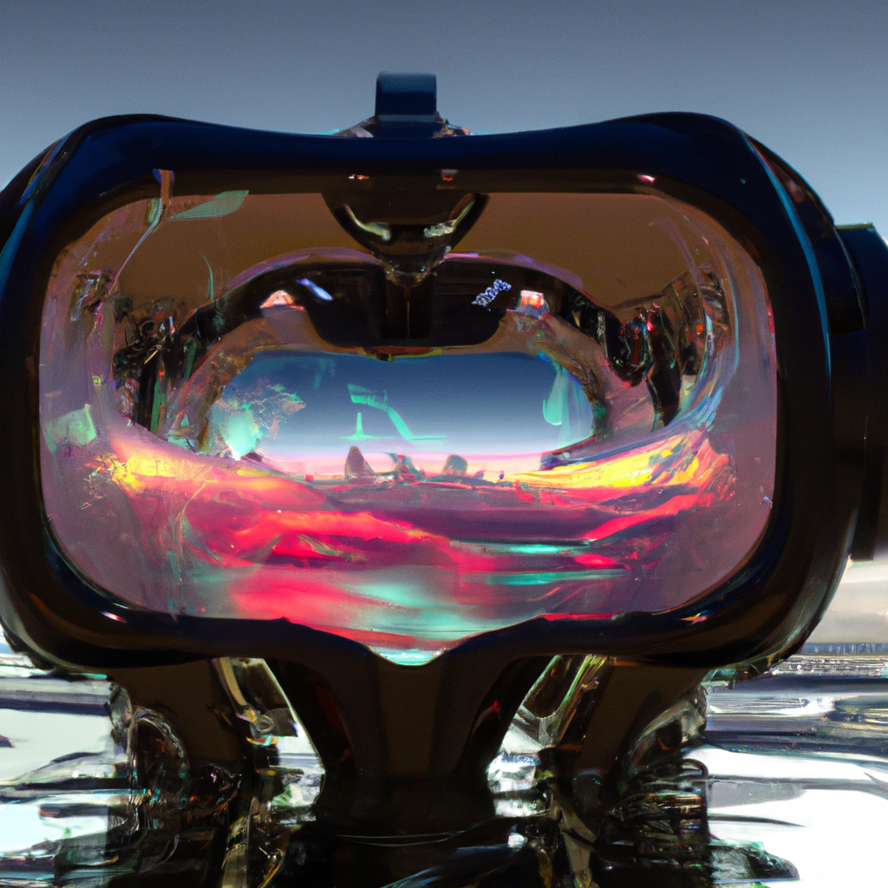
Real-World Applications of TDES for Image Encryption
Despite its many benefits, TDES also has some limitations and challenges for image encryption. One major challenge is the potential for key management issues, such as the loss or theft of encryption keys.
Another limitation of TDES is its vulnerability to brute force attacks, which involve trying every possible combination of keys until the correct one is found. To mitigate this risk, it is important to use strong, complex keys and implement additional security measures, such as key rotation and key escrow.

Slide 16
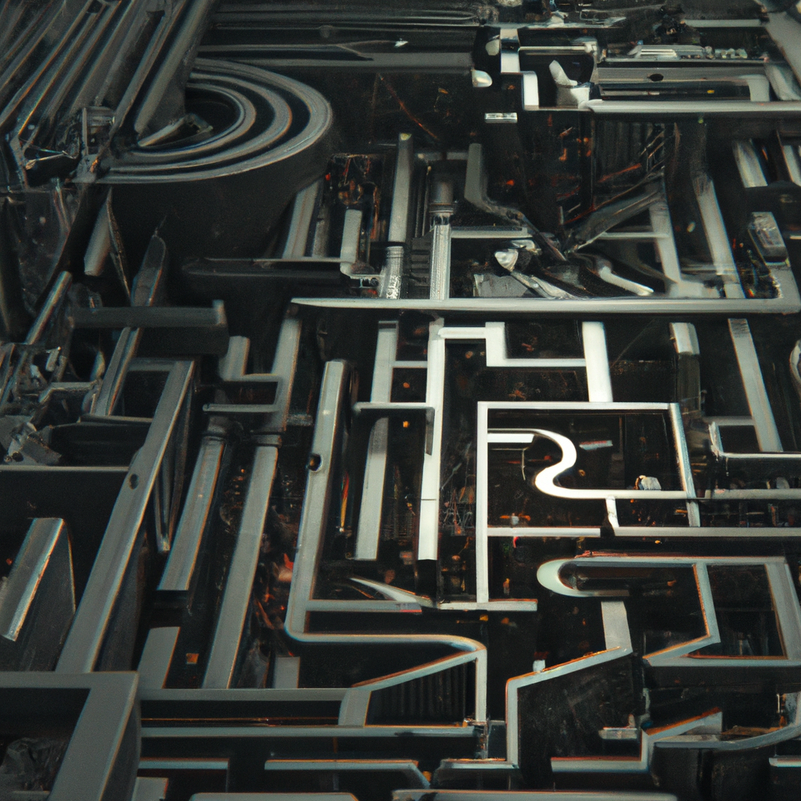
Challenges in Image Encryption and Decryption
One of the main challenges in image encryption and decryption is the need for high-speed processing. Images contain large amounts of data, and encryption and decryption can be time-consuming if not optimized.
Another challenge is the need to balance security with accessibility. While highly secure encryption techniques are desirable, they can also make it difficult for authorized parties to access the encrypted data.

Slide 17

Advantages of TDES Algorithm
The TDES algorithm is highly secure due to its use of three different keys and multiple rounds of encryption and decryption. This makes it ideal for protecting sensitive images and data.
Another advantage of the TDES algorithm is its compatibility with a wide range of devices and platforms. It can be implemented on both software and hardware platforms, making it easy to integrate into existing systems.

Slide 18
Conclusion: The Future of Image Encryption with TDES
As the world becomes increasingly digital and interconnected, the need for secure image encryption will only continue to grow. TDES offers a powerful and reliable solution for protecting sensitive and confidential images from unauthorized access and theft.
With ongoing advancements in technology and cryptography, it is likely that TDES will continue to evolve and improve in the years to come, providing even greater levels of security and reliability for image encryption

Slide 19
REFERENCES
https://www.tutorialspoint.com/cryptography/data_encrypton_standard.htm
https://www.simplelearn.com/what-is-des-article
https://pycryptodome.readthedocs.io/en/latest/src/cipher/des3.html
https://www.hypr.com/data-encryption-standard-des/
https://www.geeksforgeeks.org/data-encryption-standard-des-set-1

Slide 20
THANK YOU

